Slide 1
How to work with Git & Github using Eclipse | Commit | Push | Branching | Pull Request | Merging
1) What is Git?
2) What is Github?
3) How to Work with Git & Github in Eclipse Commit Push Pull Branching Raising Pull Request (PR) Approve Pull Request(PR) Merging

Slide 2
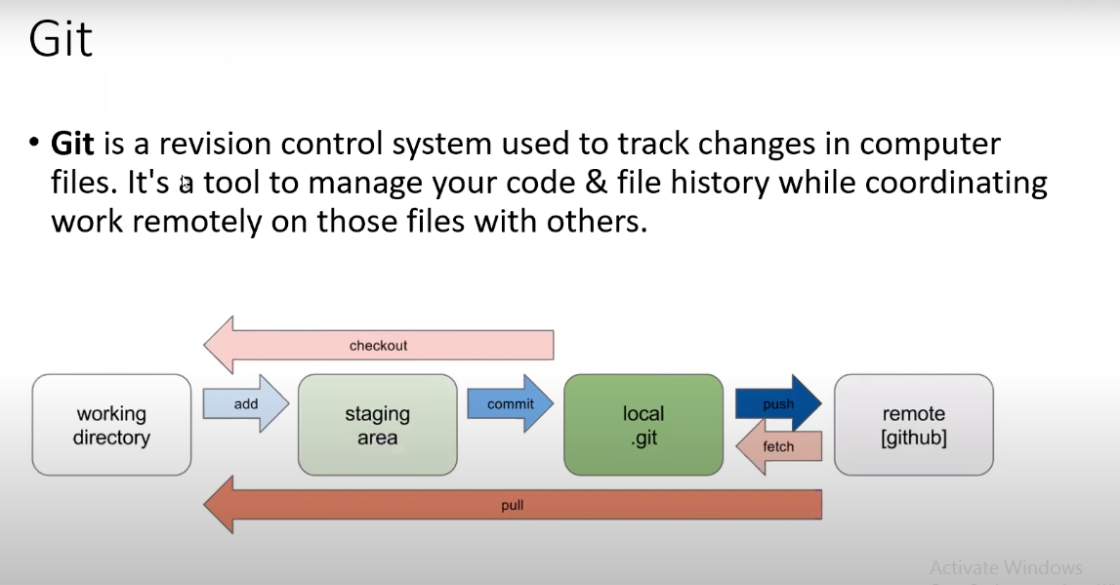

Slide 3
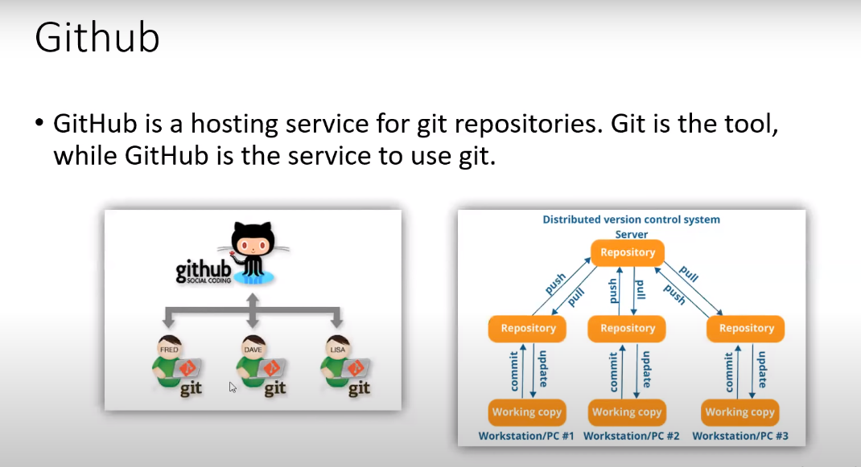

Slide 4
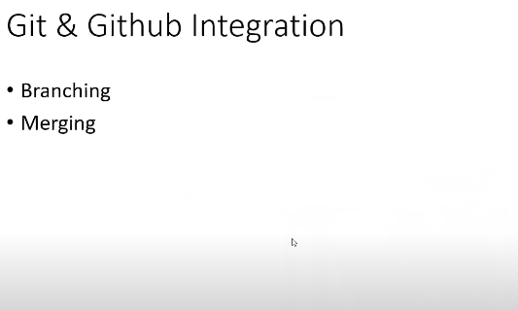

Slide 5
